Slide 1
Build’an’Office add-in- using’modern JavaScript tools and techniques
Build an Office add-in using VueJS-

Slide 2

Build an Office add-in using VueJS-
VueJS 101
Building add-ins with VueJS
Side-loading and debugging
Overview of the sample

Slide 3

VueJS 101
Vue.js is a popular open-source JavaScript framework for building user interfaces. Vue makes it easy to integrate other JavaScript libraries and is designed to be incrementally adoptable.
Vue.js was developed to build a front-end framework featuring some of the best of both React and Angular.
Core library focused on the view layer only (hence the name), and is easy to pick up and integrate with other libraries or existing projects.
Shorter learning curve for the typical front-end developer as it is easier to use without TypeScript and can leverage standard HTML templates.
Notes:
The last modern JavaScript library we will explore with Office add-ins is Vue.js
Vue.js (pronounced “View”) is a open-source JavaScript framework that is gaining in popularity. Unlike Angular, which completely takes of the front-end, Vue is designed to be incrementally adoptable and can integrate more easily with other JavaScript libraries. Originally created by a developing working at Google with AngularJS, Vue incorporates many of the best things of AngularJS and React. The Core Vue library is really focused on the view layer of MVC application (hense the name Vue). Because Vue is easy to leverage without TypeScript and it’s ability to use standard HTML templates, Vue is often perceived at having a shorter learning curve compared to React and Angular.

Slide 4
VueJS 101 - Sample
<div id="app">
<input type="text" v-model="newItem"
v-on:keyup="add(newItem)">
<ul>
<li v-for="item in items">{{item}}</li>
</ul>
</div>
var app = new Vue({
el: "#app",
data: {
newItem: "",
items: []
},
methods: {
add() {
if (event.key == "Enter") {
this.items.unshift(this.newItem);
this.newItem = "";
}
}
}
});
Points of interest
Vue object is bound to a DOM element (indicated by “el” property)
Vue object also includes data, methods, computed, components, and more
Attribute directives are prefixed with v- in markup
Events are bound with v-on and the event name
Data can be displayed inside double brackets {{}}
Very similar syntax to AngularJS
NOTE: This sample demonstrates just a small fraction of VueJS. It is meant to outline a few basic patterns of that framework.
Notes:
Here is a very basic “Hello World” Vue application. Although just a fraction of Vue’s capabilities, this highlights some key concepts and is something you could copy this into Codepen.io and run it.
Notice how the Vue object is bound to the DOM by associating it with a specific selector element (in this case #app)
The Vue object can contain a number of properties, including data, methods, components, and more
Vue leverages attribute directives very similar to AngularJS…notice directives such as v-model, v-for, and v-on.
Also notice how Vue uses double brackets to output data on the associated Vue object.

Slide 5
Building add-ins with VueJS – Project Setup
New projects
Use the Office Yeoman generator to provision a new Office add-in project using the JQuery template option
Add dependencies for vue, vue-class-component, vue-loader, vue-template-compiler, and ts-loader via package.json and npm
Configure TypeScript to support multiple modules and allowSyntheticDefaultImports
Configure webpack (webpack.config.js and package.json scripts)
Add TypeScript definition to map .vue files as TypeScript
Change app script reference to leverage the webpack bundle
Update the Office.initialize call in app.ts to bootstrap the Vue object
Existing Projects (or new project via Vue CLI)
Run the Office Yeoman generator to provision the add-in manifest
Add dependencies to Office.js and the Office UI Fabric via package.json and npm
Convert the application to run with SSL (varies by project)
Update the app entry point to bootstrap Vue to the UI inside Office.initialize
Add office.js and Office UI Fabric references to the markup page(s) (or make modifications to include them in the webpack config)
Notes:
There are two approaches to building an Office add-in with Vue.
First, there is building an Office add-in from a new project. To do this, you can either use the Vue CLI or use the Office Yeoman generator. The Office Yeoman generator doesn’t have a Vue template, but you can select a different template (such as Jquery) and convert it to use Vue. That approach has a few important considerations. First, the TypeScript compiler (assuming you build it with TypeScript) needs to know how to handle .vue component files. Secondly, only the React template in Yeoman uses webpack, so you might need to configure webpack. The instructions for that are in the lab and we will demonstrate that shortly.
The second approach is converting an existing Vue project to deliver and Office add-in. This approach is similar to using the Vue CLI. Ultimately, you need to convert the solution to debug with SSL as Office add-ins are required to use SSL. Depending on your local hosting configuration, this could be as easy as flipping a SSL flag or a complex as creating a self-signed certificate for the web application. You also need to run the Office Yeoman generator to at least provision an Office add-in xml manifest and add references to Office.js (and Office UI Fabric) in the project.

Slide 6
Office.initialize and VueJS
// Bootstrap root component in Office.initialize
Office.initialize = (reason) => {
var app = new Vue({
el: "#app",
render: h => h(root, { }),
components: { root }
});
};
Notes:
One of the most important aspects of using a modern client-side framework with Office add-ins is how the framework is bootstrapped to the markup. Every page that loads in the add-in must call Office.initialize before running other scripts. It is a best practice to bootstrap Vue to the DOM WITHIN the Office.initialize callback as seen here.

Slide 7
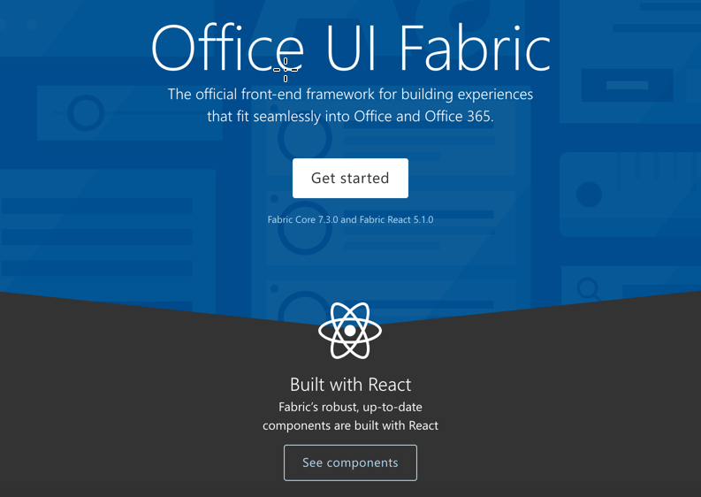
Building add-ins with VueJS – Office UI Fabric
Office UI Fabric React
Includes 40+ robust and up-to-date components built with the React framework
Can be integrated into a Vue project, but requires hybrid Vue/React setup and some script might conflict with Vue’s virtual DOM
Best to build components with the Office UI Fabric Core or wrap React components in Vue components
Office UI Fabric Core
Includes styles, icons, typography, brand icons, colors, grids, and more.
Notes:
The Office UI Fabric does no offer Vue components, but you can deliver a hybrid approach of wrapping React components in Vue components
OR
You can leverage Office UI Fabric Core to basic styles, colors, icons, typography, etc. These can also be easily integrated in custom Vue components.

Slide 8
Side-loading and debugging
Side-loading (All environments)
Start the web host
Ensure your browser will accept the SSL certificate
Create a new Office Online document
Upload the manifest through the insert Office add-in dialog
Side-loading (Win32 Office Client)
Create a local share in the file system
Copy your manifest file to this local share
Open the Win32 Office client
Add the local share to the Trusted Add-in Catalogs in the Trust Center > Trust Center Settings menu
Debugging in Office Online
Leverage the browser developer tools (F12) for debugging
Debugging in Win32 Office from Visual Studio
Open the menu in the top right corner of the task pane
Select Attach Debugger to launch the Visual Studio Just-in-Time Debugger
Notes:
For side loading and debugging Vue add-ins, the approach is unchanged. Office Online is available to all developer environments as involves uploading the add-in xml manifest through a new Office document in Office Online (via OneDrive). Debugging can be done with the browser developer tools.
For Windows users, you can side load the add-in by creating a local network share, placing the add-in xml manifest in that share, and configuring the Office Client to look for add-ins in this location (via the Trusted Add-in Catalog settings of Trust Center). Visual Studio users can even attach a debugger to task pane add-ins running in the Win32 Office client.

Slide 9
Demo
Notes:
In this demo, I’ll provision a new Office add-in and configure it to work with Vue.js
1. Open the Demo/Lab markdown for this section in the module
2. Complete the Provision the Office add-in and Side-load the Office add-in steps
3. Update the code in Office.initialize to update the A1 cell of the worksheet:
await Excel.run(async (context) => {
var sheet = context.workbook.worksheets.getActiveWorksheet();
var range = sheet.getRange("A1:A1");
range.values = [["Hello World"]];
await context.sync()
});
4. Run the complete solution located in the Demos/03 Build Add-in using VueJS folder
Stop the server on the previous steps
Clone
Run npm install
Run npm run start
Side-load the add-in (or just refresh the one already running as it uses the same port)

Slide 10

Summary
New project can originate using the Office Yeoman generator with or without the Vue CLI
You must bootstrap the root Vue object/component inside Office.initialize
You can wrap Office UI Fabric components in Vue components or use Office UI Fabric Core

Slide 11
Reading further
Create and Office Add-in using any editor
https://dev.office.com/docs/add-ins/get-started/create-an-office-add-in-using-any-editor
Side-loading Office Add-ins for testing
https://dev.office.com/docs/add-ins/testing/create-a-network-shared-folder-catalog-for-task-pane-and-content-add-ins
Side-loading Office Add-ins in Office Online for testing
https://dev.office.com/docs/add-ins/testing/sideload-office-add-ins-for-testing

Slide 12
Thank you

